Slide 1
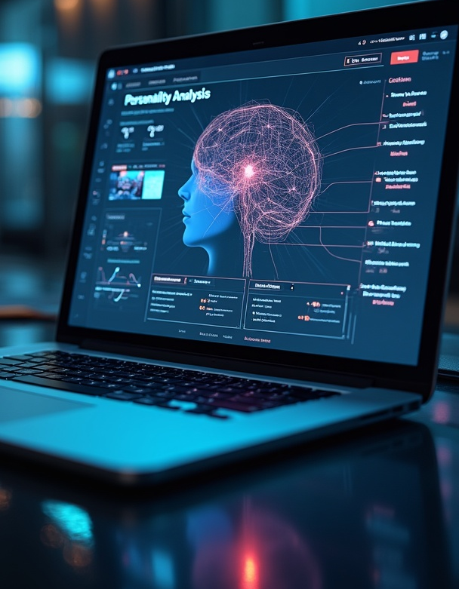
AI-Based Personality Predictor
A web application leveraging AI to predict user personality types.

Slide 2
Introduction
This presentation discusses the AI-based personality predictor project, focusing on its purpose, functionality, and required technologies.

Slide 3

01
Overview

Slide 4
Project purpose and objectives
The AI-Based Personality Predictor is designed to analyze user inputs and classify them into distinct personality types, such as Introvert, Extrovert, or Ambivert. This tool aims to provide insightful feedback based on user preferences, which can be helpful for applications in educational counseling, social platforms, and human resource profiling.

Slide 5

Technical stack and frameworks
The application is built using Python's Flask framework for backend development, which ensures a robust server-side operation. The frontend is crafted with HTML and CSS, providing a user-friendly interface. Integration with the Ollama LLM API and the Gemma 2B model allows for effective processing of user inputs and generation of personality insights.

Slide 6
Integration with AI models
This application utilizes the Ollama LLM API in conjunction with the Gemma 2B model to process user inputs. The integration allows for natural language understanding, which is crucial for accurately interpreting the answers provided by users. By dynamically compiling input responses into a custom prompt, the model generates a concise analysis to determine the user's personality type.

Slide 7

02
Functionality

Slide 8
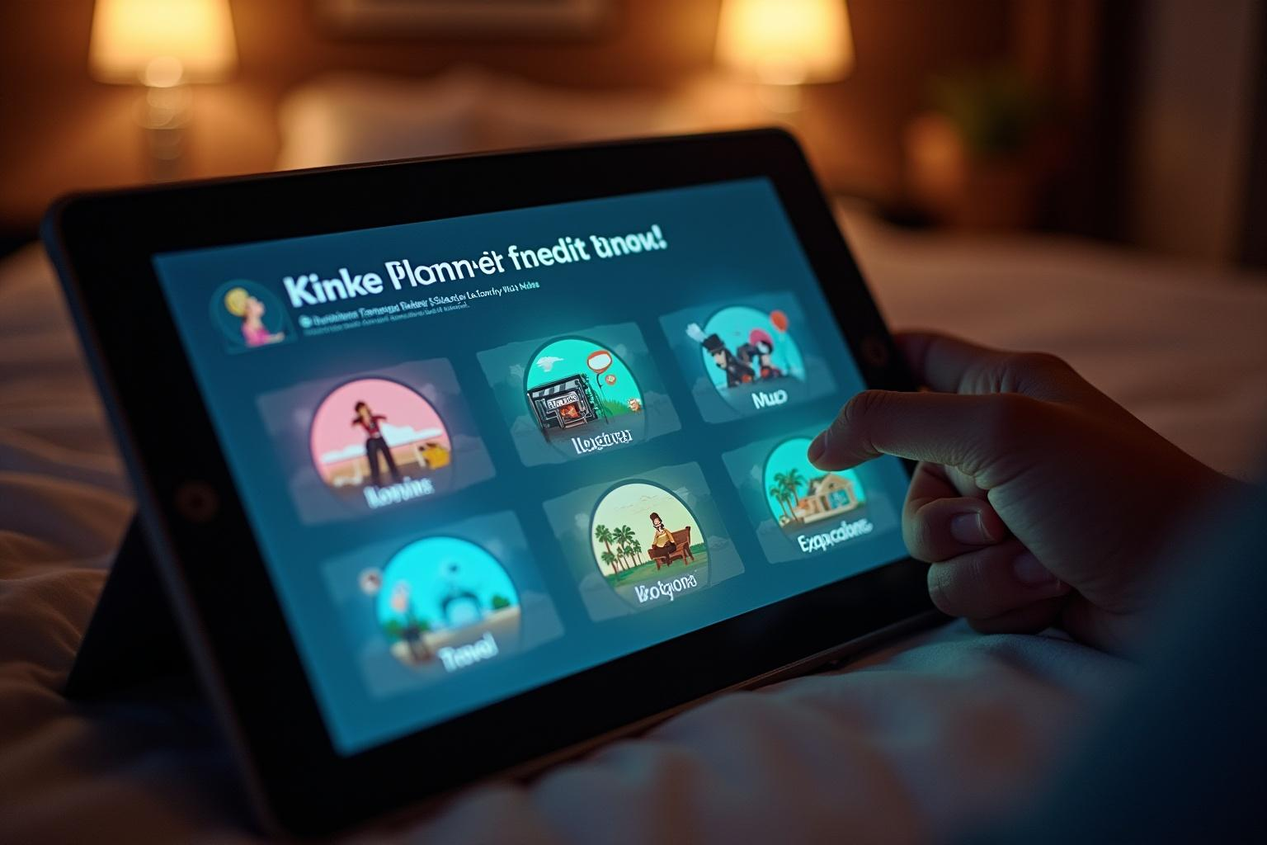
User input process
Users engage with the application through six tailored prompts that query their preferences, including favorite movies, music genres, cartoons, hobbies, favorite places, and preferred pastimes. This streamlined input process ensures that users can easily interact with the application, providing essential data for personality assessment.

Slide 9
Analysis and interpretation
Once the user inputs are collected, the AI processes the responses using advanced natural language processing techniques. The analysis involves evaluating the user's preferences and categorizing them into personality types. The application then presents the results along with reasoning, helping users understand the basis for their personality classification.

Slide 10
Applications and future enhancements
This personality predictor application can be expanded for educational purposes, social networking, and human resource profiling. Future improvements may include personality visualization features, database connectivity for tracking user inputs and results over time, and enhanced deployment options via cloud platforms to increase accessibility.

Slide 11
Conclusions
The AI-Based Personality Predictor demonstrates the potential of leveraging AI in everyday applications for psychological insights. By integrating user-friendly designs with robust AI technologies, the project showcases advancements in natural language processing that can be utilized across various fields, offering significant value for users.

Slide 12
Thank you!
Do you have any questions?
+00 000 000 000

